Slide 1

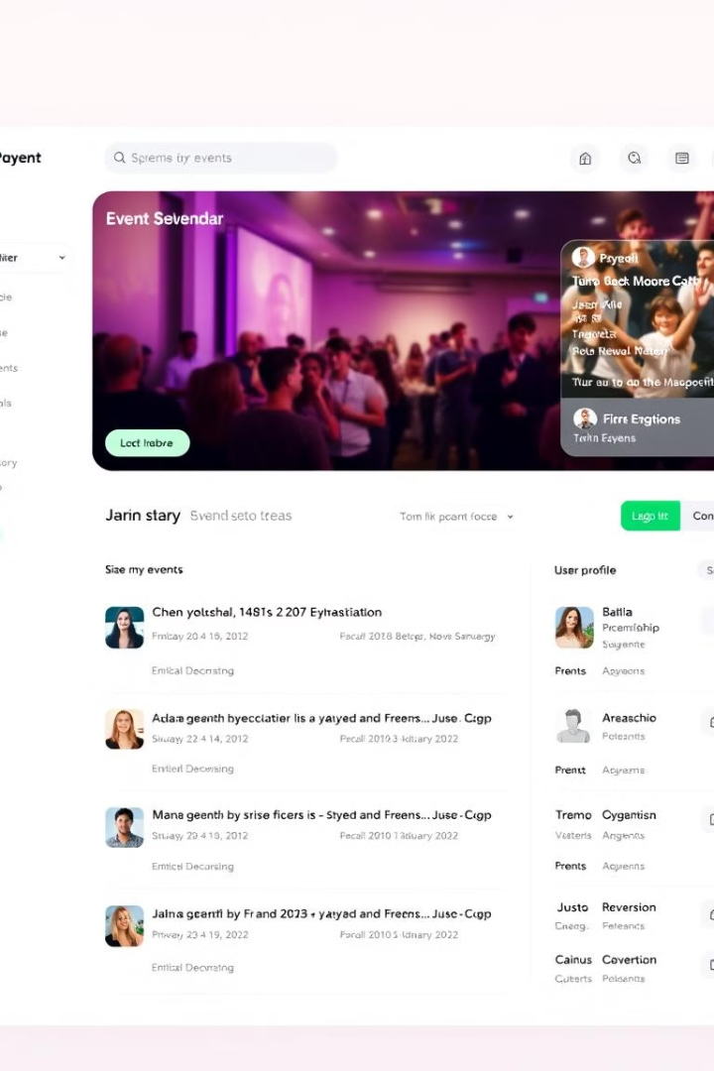

EventPro: Streamlining Event Management
EventPro is a C-based application designed to simplify event management for organizations. It offers features like user authentication, event scheduling, participant registration, and real-time notifications.
by Bushra Fatima
SAKSHI 24CSU288
ARYAN 24CSU285
BUSHRA 24CSU265

Slide 2

Project Objectives
1
Seamless Login
2
Event Management
Provide a seamless login and user authentication system.
Facilitate event creation and management.
3
Event Notifications
4
Participant Data
Ensure effective notification alerts for upcoming events.
Maintain participant data for scheduled events.

Slide 3
Functional Requirements
User Authentication
Event Management
Users can sign up with a username and password.
Register new events with details like name, date, time, and description.
Users can log in to their accounts securely.
Add and list participants for each event.
Update event details as necessary.

Slide 4
Notifications and Data Storage
Notifications
Data Storage
Notify users of events scheduled within the next hour or happening on the current day.
User accounts and event details are stored in plain text files for simplicity.

Slide 5
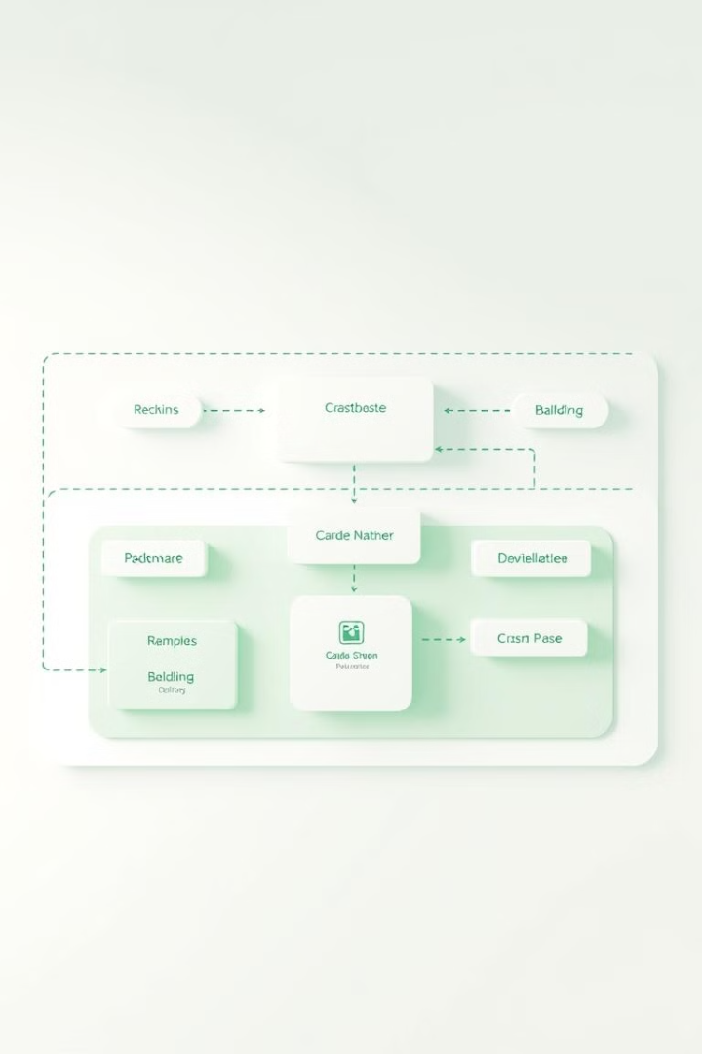
Non-Functional Requirements
Performance
Security
Handle up to 100 participants per event and efficiently manage up to 50 events per user.
Basic encryption (future scope) for sensitive user data such as passwords.
Scalability
Ability to increase the number of users by scaling file-based storage.

Slide 6
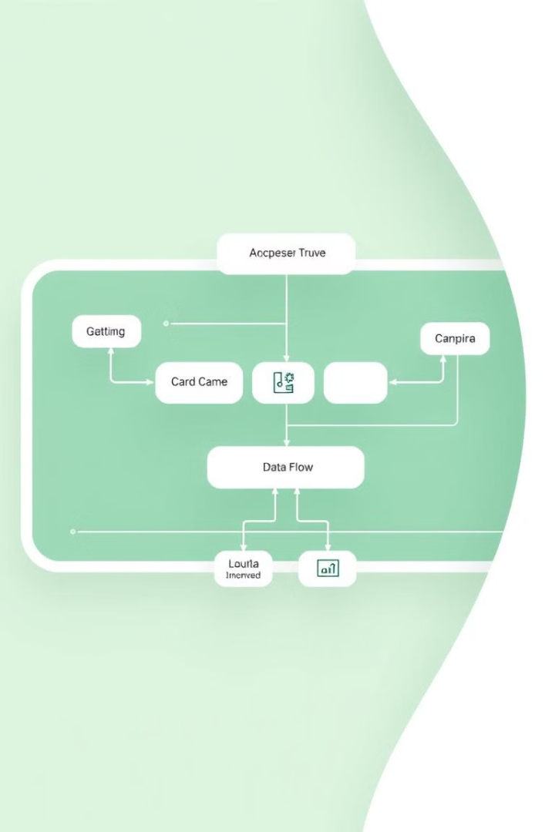



System Architecture Overview
Login Module
Event Management Module
Handles user sign-up and authentication.
Allows event creation, updates, and participant management.
Notification Module
Monitors event timings and generates notifications.

Slide 7
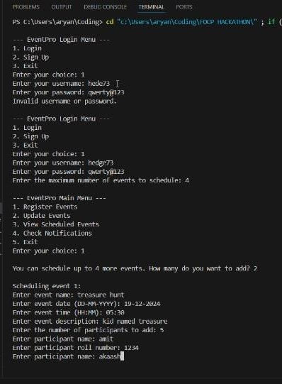
Technologies Used
1
Programming Language
2
File Handling
For storing user and event data.
C
3
Time Functions
For handling event scheduling and notifications.

Slide 8
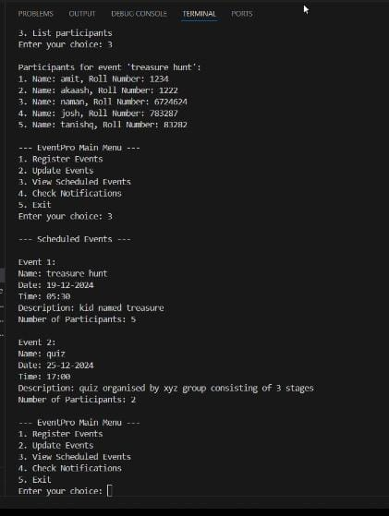
Timeline and Milestones
1
Phase 1
Requirement gathering and design – (Completed).
2
Phase 2
Development – (Complete).
3
Phase 3
Testing – (Done]).
4
Phase 4
Final presentation and submission – (Planned for [20-12-2024]).

